Slide 1

Module 3
Mgmt 6062 - Project Risk and Quality
There are slide notes in this PowerPoint, make sure your notes pane is visible below the slide pane

Slide 2
Module agenda
Identifying Risks
Additional information needed
Suggestions
Well-defined risks
Methods of documenting risks
Methods of identifying risks
Beginning of risk register
Kilimanjaro Expedition – identify risks and begin risk register
Homework/Evaluations

Slide 3
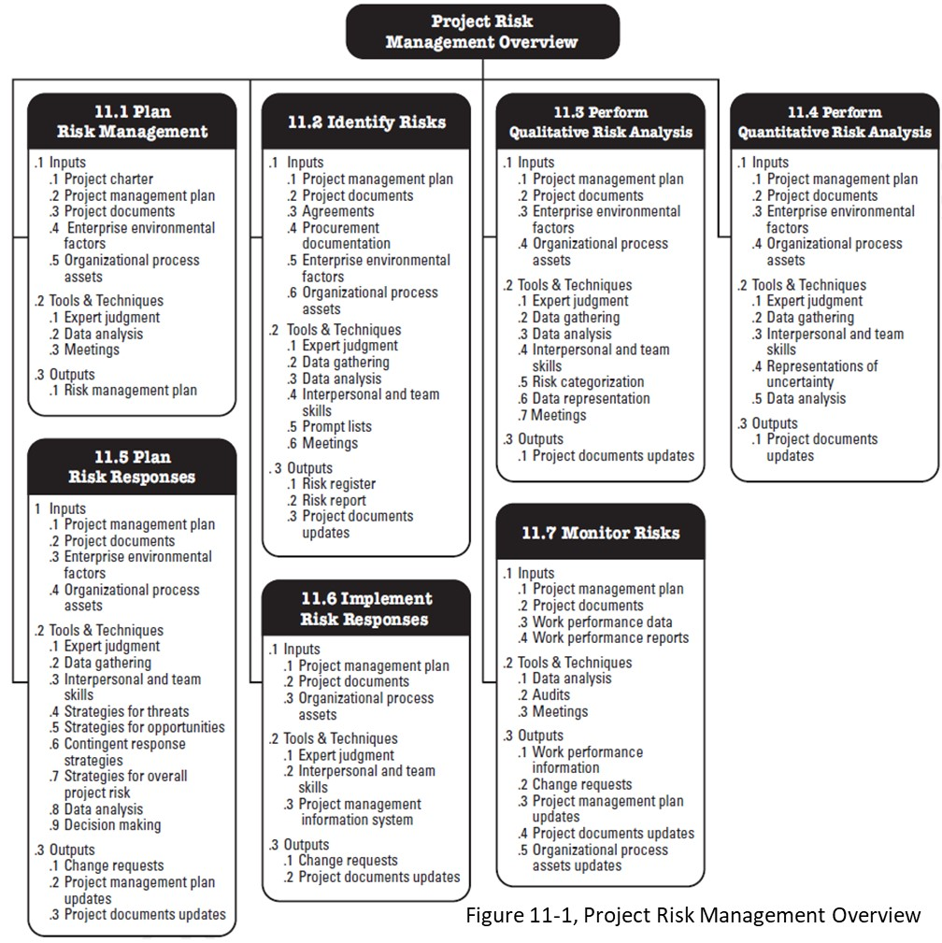
Identify risks

Slide 4

Risk management process
11.1 Plan Risk Mgt
Develop Risk Register
11.3 Qualitative Risk Analysis
11.4 Quantitative Risk Analysis
11.5 Plan Risk Responses
11.6 Implement Risk Responses
11.7 Monitor Risks
11.2 Identify Risks
IMPORTANT: Iterative process throughout the entire project life cycle

Slide 5
11.2 identify risks
Objective: Develop a long list of risks specific to the project
Key Output: Start of risk register

Slide 6
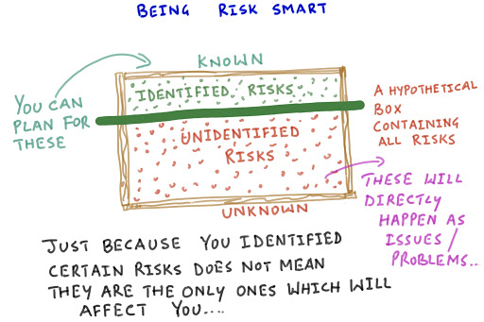
Objective: reduce number of unidentified risks.
A hypothetical box containing all risks:
Notes:
Image http://www.pm-pulse.com/BlogDetails.aspx?id=92F78170650FAD0A

Slide 7
risk register
Used for the entire risk management process.
Various formats (a template is provided for assignments)
We will be working on a risk register activity that we start today and continue for several modules.
The risk register at the end of process11.2 includes:
List of risks
Root causes
Potential risk owners (confirm later)
Potential responses to risks
Triggers (warning sign that risk has or will occur)
Updated risk categories

Slide 8
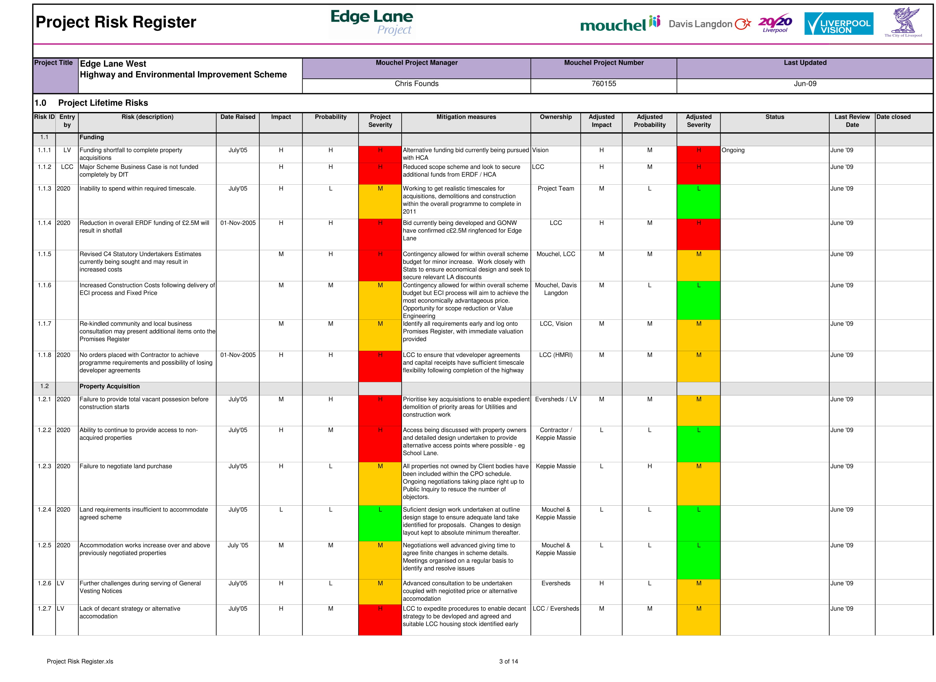
risk register
Just one example. Design of risk register depends on organizational requirements, project complexity/ scope, etc.

Slide 9
Information required before identifying risks
All inputs as discussed in Module 2 are necessary.
Accumulate as much information as possible about the project by asking questions of the signer of the project charter.
Have a complete scope of work and complete requirements before you begin the identify risks process.
Notes:
Image http://www.pm-pulse.com/BlogDetails.aspx?id=92F78170650FAD0A

Slide 10
Determine who has insight into risk on the project
Use the stakeholder register to involve the right stakeholders in the Identify Risks process
Involve the workers
Use published articles
Use involvement with associations
Consider your competition (what are they doing?)
Include your customers
Who else?

Slide 11

Suggestions for identifying risks
Limit the use of software (25% less effective)
Plan for risk identification meetings
Meet face-to-face if possible
Considerations for risk identification with virtual teams
Meet offsite, if needed
Properly name risks (risk vs. fact; be precise)

Slide 12
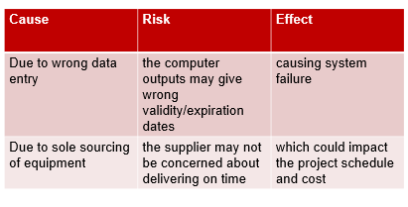
Well-defined risks
Use the Cause-Risk-Effect format to create well-defined risks.
Be careful: many risks initially identified are not risks but causes or effects.
Read as: “Due to (definitive cause), (uncertain event - risk) may occur, which would/could/may lead to (effect)”

Slide 13
things to consider
Effects can be more than just time and cost implications.
A threat is not an excuse for poor project management.
Make separate lists of threats and opportunities to prevent identifying only threats.
Include risks related to integration (e.g., activity A may not provide the information activity B needs; A may not complete in time for B to start)
Look at assumptions (i.e., could be a risk)
Spend time on opportunities first to build optimism.
Notes:
If the risk possibly delays the activity it does not necessarily delay the project if it is not on the critical path. Just listing time or cost delay as an effect does not provide enough information. Provide lots of detail so that there is lots of info for risk analysis and response development.
A risk of not having resources available due to upper management not supporting the project is really a risk due to the project manager not doing what they should be doing. The project manager should have cut scope, crashed, fast tracked, adjusted quality, or taken some other measure to deal with the resources issues rather than waiting until the risk identification process and saying the project cannot be completed on time.
Some risks need investigation and clarification while still in planning. A good project manager would ask about the threat above, ”Do you have any specific reasons for concern? Has this happened before? What leads you to think this is a possibility on this project?”
Integration is the project manager’s role of putting all the pieces of the project together into a cohesive whole. Activity A may not provide the information Activity B needs, A may not complete in time for B to start. Etc.
A great project manager will look at assumptions to see if they add to the list of risks
You are striving to identify as many risks as you can

Slide 14
Cause-risk-effect format
Write the following threats in cause-risk-effect format. There are multiple ways to present each one.
Reminder to read as: “Due to (definitive cause), (uncertain event - risk) may occur, which would/could/may lead to (effect)”
Situation | Cause | Risk | Effect
Example: Low enrollment of international students | Canadian Embassy workers on strike | Low enrollment of international students | Lost revenue to Fanshawe College and cancelled programs
College-wide power outage at college
Student is injured and sues college

Slide 15
Example of INCORRECT Cause-risk-effect format
Reminder to read as: “Due to (definitive cause), (uncertain event - risk) may occur, which would/could/may lead to (effect)”
Situation | Cause | Risk | Effect
INCORRECT
Go over budget on $400k budget for new house construction | Increase in cost of building materials | Go over budget on $400k budget for new house construction | Over budget
CORRECT
 | Procurement issues related to COVID19 restrictions | An increase in cost of building materials | Go over budget on $400k budget for new house construction

Slide 16
Cause-risk-effect format
Write the following threats in cause-risk-effect format. There are multiple ways to present each one.
Reminder to read as: “Due to (definitive cause), (uncertain event - risk) may occur, which would/could/may lead to (effect)”
Situation | Cause | Risk | Effect
Example: Low enrollment of international students | Canadian Embassy workers on strike | Low enrollment of international students | Lost revenue to Fanshawe College and cancelled programs
College-wide power outage at college
Student is injured and sues college

Slide 17
Cause-risk-effect format
Write the following threats in cause-risk-effect format. There are multiple ways to present each one.
Reminder to read as: “Due to (definitive cause), (uncertain event - risk) may occur, which would/could/may lead to (effect)”
Below are some examples from students
Situation | Cause | Risk | Effect
Example: Low enrollment of international students | Canadian Embassy workers on strike | Low enrollment of international students | Lost revenue to Fanshawe College and cancelled programs
College-wide power outage at college | Electrical storm | College-wide power outage | Cancellation of classes for day; loss of learning
Student is injured and sues college | Slippery, wet floor | Student fall | Student is injured and sues college

Slide 18
Methods of identifying and documenting risks
Forms: What are advantages and disadvantages of using forms?
Identification of Threats and Opportunities Chart |  | Risk Name | Risk Description | Negative Risk, Positive Risk or both?
Overall project Risks
Risks per activity | Activity A
 | Activity B
 | Activity C
Notes:
Pros:
Fast, commonly used for other work activities so people feel comfortable with them, help accumulate input from many people in a short time, a convenient way to gain contribution of those who do not want to spend much time on the project
Cons:
- Does not allow for group thought or opinion, do not encourage to think outside the box – people just fill out the form, does not allow for in-depth analysis of risk, some people are more verbal and require a verbal method to come up with the best risks, do not allow for unlimited ideas – people will fill in form and will stop when form is full, people take risk identification more seriously if other methods are used.

Slide 19
Methods of identifying and documenting risks
Checklists: What are advantages and disadvantages of using checklists?
Risk Checklist
Category | Cause of Risk | Previous History with this risk? | Relevant to This Project? | Potential Impact (High, Medium, Low)
1. Product or Technical | New Technology
 | Integration requirements with other systems
 | Training capabilities
2. External sources | Changing Customer Requirements
 | Regulatory changes
 | Supplier availability
 | Weather
 | Competitor activities
Notes:
Pros: Get a quick sense of level of risk and overview of risks on project, help generate conversation about risk, useful memory joggers.
Cons: do not identify risks by activity or work package; do not provide enough details of risks, their causes or effects; do not provide for someone to add a risk that is not on the form, are not project-specific, provide false sense that all risks have been identified, lead to “in the box thinking”, do not help to assess, qualify or quantify risks

Slide 20

Identifying risks and risk categories
A source for possible risks and risk categories:
http://management.simplicable.com/management/new/130-project-risks
Sample risk categories
Financial
Technical
Commercial
Execution
Contractual

Slide 21
Methods to identify risks
Delphi technique
Cause and effect diagram
Failure modes and effects analysis
SWOT analysis
Root cause analysis
Assumptions analysis
System or process flow charts
Influence diagrams
Prompt list or check list
List of possible risks
Use your own company’s historical records and other documentation
Brainstorming
Affinity diagrams
Expert interviews
Nominal group technique

Slide 22
From last week: Risk management plan
The risk management plan is developed BEFORE identifying project-specific risks
The risk management plan includes:
Methodology
Roles and responsibilities
Budget for risk management activities
Timing
Definitions of probability and impact
Stakeholder tolerances
Reporting formats
Tracking
This is where you would identify your preferred approach for risk identification for the project.

Slide 23
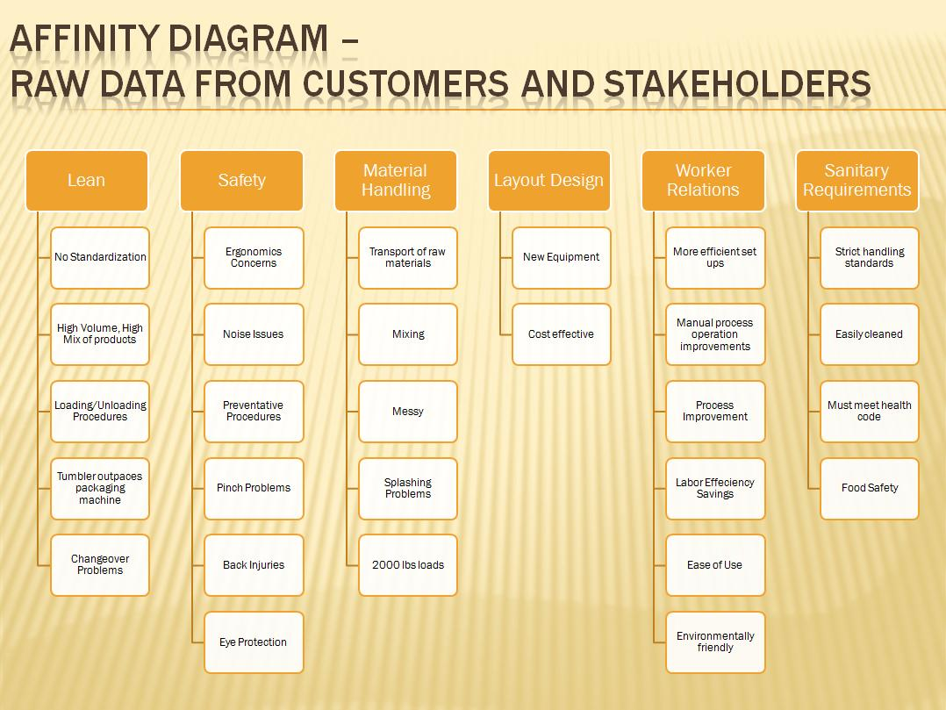
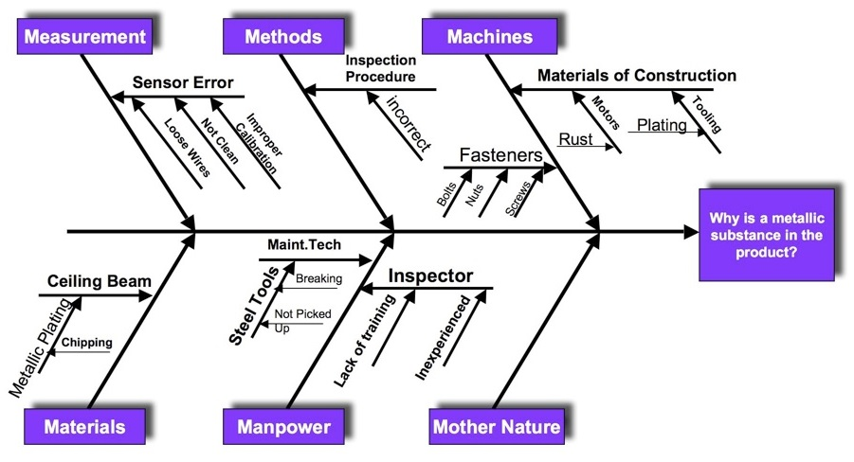
Methods to identify risks
Cause/effect diagram
(aka Ishikawa, Fishbone Diagram)

Slide 24
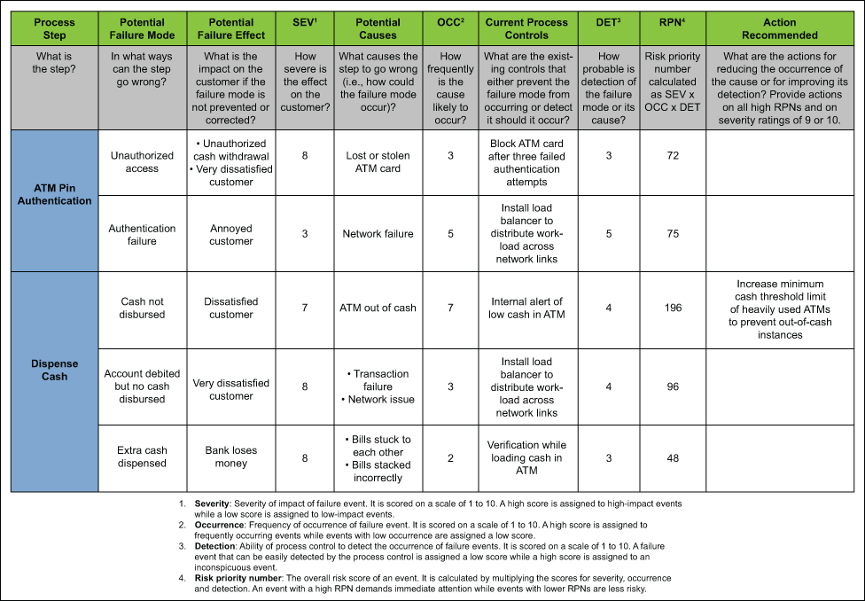
Methods to identify risks
Cause/effect diagram
(aka Ishikawa, Fishbone Diagram)
Operational Risk Assessment Form

Slide 25
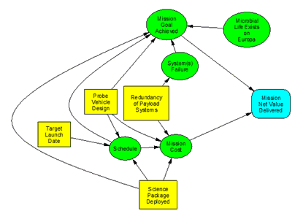
Methods to identify risks
Influence Diagram

Slide 26
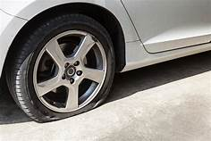
Methods to identify risk
Root cause analysis:
“5 Whys” Method
Consider: why do I have a flat tire?

Slide 27
Methods to identify risk
Root cause analysis:
“5 Whys” Method
Consider: why do I have a flat tire?
1 Why?
2 Why?
3 Why?
4 Why?
5 Why?

Slide 28
Overview of identify risks process
Collect historical information.
Determine who may have insight to risks.
Determine which risk identification methods to use (likely more than one)
Identify risks.
List all risks on a risk register.
Determine how confident you are that major risks have been identified.
If not confident, redo previous steps. If confident, determine what information is still needed.
Ask remaining questions and collect information.
Add new risks to list and eliminate items that are not really risks.
Discuss remaining risks as necessary to understand them.
Include potential risk responses, potential risk owners and triggers

Slide 29
What is a trigger?
An early warning sign that tells risk owners and project managers that a risk has occurred or is about to occur and, therefore, when to implement the contingency plan
Examples:
Server capacity alarm
Weather forecast
Process control
Loss of a key resource
Questions to consider to determine triggers:
What will happen just before this risk occurs?
What can we measure to discover that the risk is about to occur?
How will we know right away when the risk occurs?

Slide 30

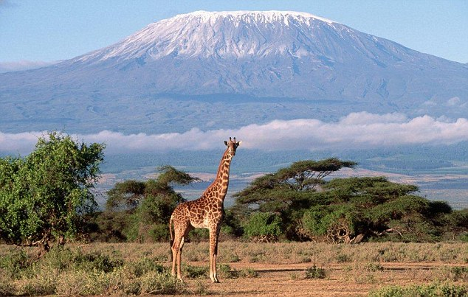
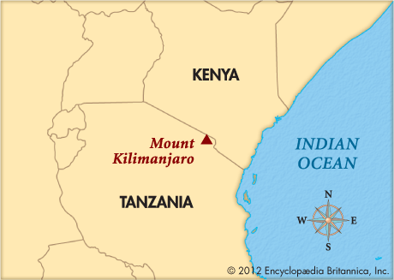
Mount Kilimanjaro expedition (This topic Not to be used for graded assignments)
We will use this example project over several modules to develop a risk register and risk response plan
Video: https://www.youtube.com/watch?v=XRwrpXf5V6c
As you watch the video, imagine you are the project manager for a Mount Kilimanjaro Expedition. Write down potential risks as a starter for our risk register.
Expedition details provided on FOL file M3 Kilimanjaro Expedition.pdf.
FOL File
This Kilimanjaro project is not to be used as a topic for your graded assignments

Slide 31
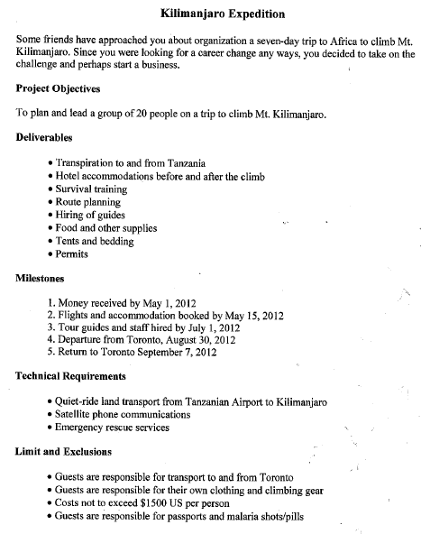

Slide 32
Mount Kilimanjaro expedition risk identification
After you’ve finished watching the video:
Brainstorm overall project opportunities.
Brainstorm overall project threats
Brainstorm risks (opportunities and threats) per activity.
Look at risks and risk categories in http://management.simplicable.com/management/new/130-project-risks and https://rmcls.com/bundler-app/public/assets/downloads/extras/pdfs/pm-crash-course-it-pro/Ch_13_Potential_Risk_Categories.pdf
Organize risks in categories: Financial, Technical, Commercial, Execution, Contractual/Legal.
Capture your risks (paper or digital) in a cause-risk-effect format for later use, you can alternatively enter them in your Risk Register.xls file found on FOL.
FOL File

Slide 33
Mount Kilimanjaro expedition
Cause | Risk | Effect

Slide 34
Homework and/or evaluations
Upcoming M4 readings per Course at a Glance summary (i.e., readings from Kerzner, PMBOK, Newton)
Assignments and quizzes, check the Course at a Glance and FOL/Content/Course Assignments & FOL/Evaluations/Quizzes
M5 Quiz
Covers content in M1 to M5
MS, MC, calculations
A focus on the numeric (math) calculations and exercises found in the M5 PPT

